Slide 1
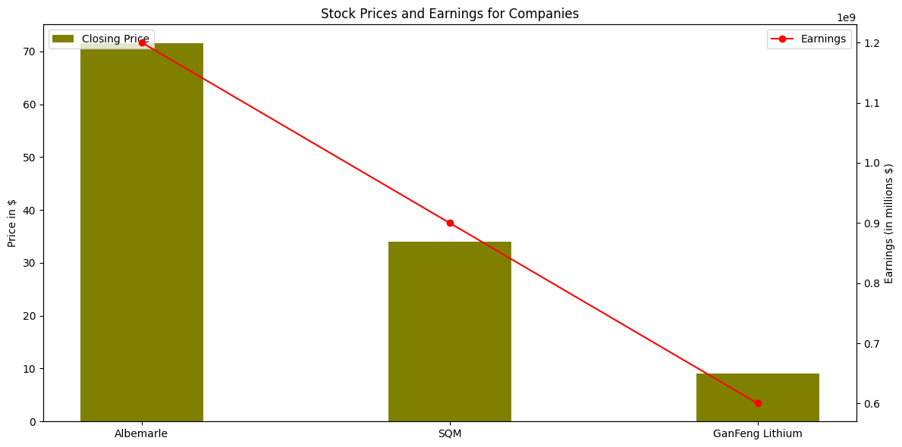
Best Performing Li-on Mining’s From Jan - Jun 2019
Albemarle Corporation (ALB)
GanFeng Lithium
Key Trend: Strong demand for lithium-ion batteries, strategic partnerships.
Reason: Expansion in lithium production and favourable market conditions.
Key Trend: Investments in low-cost projects, strategic acquisitions and demand for EV sector
Reason: this was second largest producer, but due to Oversupply issues and higher productions it started downfall.
SQM
Key Trend: Increased production capacity, strong global demand.
Reason: Efficient production processes and Strategic investments.

Slide 2
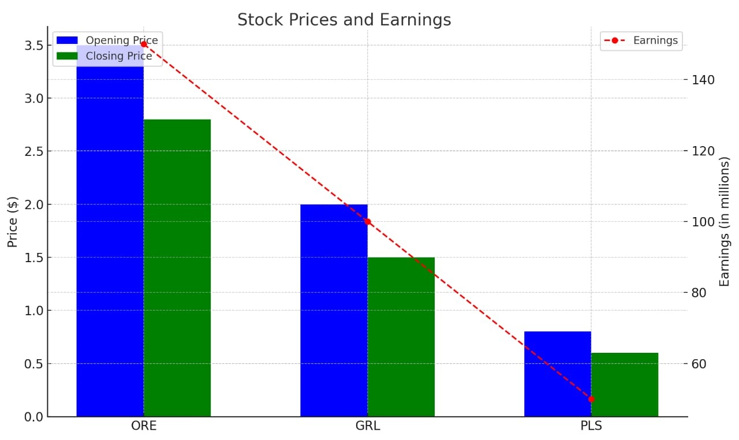
Worst Performing Li-on Mining’s From Jan - Jun 2019
Orocobre Limited (ORE)
Galaxy Resources Limited (GRL)
Pilbara Minerals Limited (PLS)
Key Trends Lead to Down Fall
Increased Competitions
Sales Expectation
Declining Demand

